Slide 1
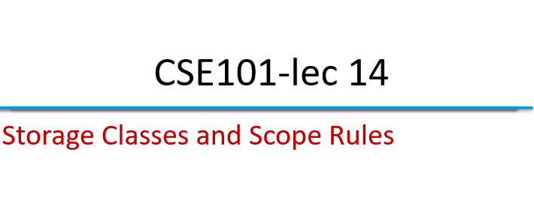

Slide 2

Outline
Storage Classes
auto
static
extern
register
Scope Rules

Slide 3
Storage Classes
Storage class specifies
Storage duration – how long the variable retains a particular value
Scope – or visibility of the variable i.e the portion of the program within which the variables are recognized.

Slide 4
Storage Classes: Auto
Automatic storage
auto int x, y;
It is the default storage class
Storage − Memory.
Default initial value − An unpredictable value, which is often called a garbage value.
Scope − Local to the block in which the variable is defined.
Life − Till the control remains within the block in which the variable is defined.

Slide 5
Storage Classes: Register
register: tries to put variable into high-speed registers.
register int counter = 1;
Storage - CPU registers.
Default initial value - Garbage value.
Scope - Local to the block in which the variable is defined.
Life - Till the control remains within the block in which the variable is defined.

Slide 6
Storage Classes: Static
Static storage
Storage − Memory.
Default initial value − Zero.
Scope − Local to the block in which the variable is defined.
Life − variable will retain throughout the program

Slide 7
Storage Classes: extern
Default for global variables and functions
Known in any function
Storage − Memory.
Default initial value − Zero.
Scope − Global.
Life − As long as the program’s execution doesn’t come to an end.

Slide 8
Scope Rules
The scope of a variable is the portion of a program where the variable has meaning (where it exists).
A global variable has global (unlimited) scope.
A local variable’s scope is restricted to the function that declares the variable.
A block variable’s scope is restricted to the block in which the variable is declared.

Slide 9
Local variables
Parameters and variables declared inside the definition of a function are local.
They only exist inside the function body.
Once the function returns, the variables no longer exist!
That’s fine! We don’t need them anymore!

Slide 10
Block Variables
You can also declare variables that exist only within the body of a compound statement (a block):
{
int f;
…
…
}

Slide 11
Global variables
You can declare variables outside of any function definition – these variables are global variables.
Any function can access/change global variables.

Slide 12

Global Scope:
Cruising speed
Cruising Height
Local Scope:
Distance to destination
Block Scope:
Landing Gear state
Rudder tilt

Slide 13
Example code
#include <stdio.h>
void useLocal( void ); /* function prototype */
void useStaticLocal( void ); /* function prototype */
void useGlobal( void ); /* function prototype */
int x = 1; /* global variable */
/* function main begins program execution */
int main()
{
int x = 5; /* local variable to main */
printf("local x in outer scope of main is %d\n", x );
{ /* start new scope */
int x = 7; /* local variable to new scope */
printf( "local x in inner scope of main is %d\n", x );
} /* end new scope */
printf( "local x in outer scope of main is %d\n", x );
This program demonstrates each storage class and scopes of variables

Slide 14
Example code
useLocal(); /* useLocal has automatic local x */
useStaticLocal(); /* useStaticLocal has static local x */
useGlobal(); /* useGlobal uses global x */
useLocal(); /* useLocal reinitializes automatic local x */
useStaticLocal(); /* static local x retains its prior value */
useGlobal(); /* global x also retains its value */
printf( "local x in main is %d\n", x );
return 0; /* indicates successful termination */
} /* end main */
/* useLocal reinitializes local variable x during each call */
void useLocal( void )
{
int x = 25; /* initialized each time useLocal is called */
printf( "\nlocal x in a is %d after entering a\n", x );
x++;
printf( "local x in a is %d before exiting a\n", x );
} /* end function useLocal */
This program demon-strates each storage class and scopes of variables

Slide 15
Example code
/* useStaticLocal initializes static local variable x only the first time
the function is called; value of x is saved between calls to this
function */
void useStaticLocal( void )
{
/* initialized only first time useStaticLocal is called */
static int x = 50;
printf( "\nlocal static x is %d on entering b\n", x );
x++;
printf( "local static x is %d on exiting b\n", x );
} /* end function useStaticLocal */
/* function useGlobal modifies global variable x during each call */
void useGlobal( void )
{
printf( "\nglobal x is %d on entering c\n", x );
x *= 10;
printf( "global x is %d on exiting c\n", x ); }
This program demon-strates each storage class and scopes of variables

Slide 16
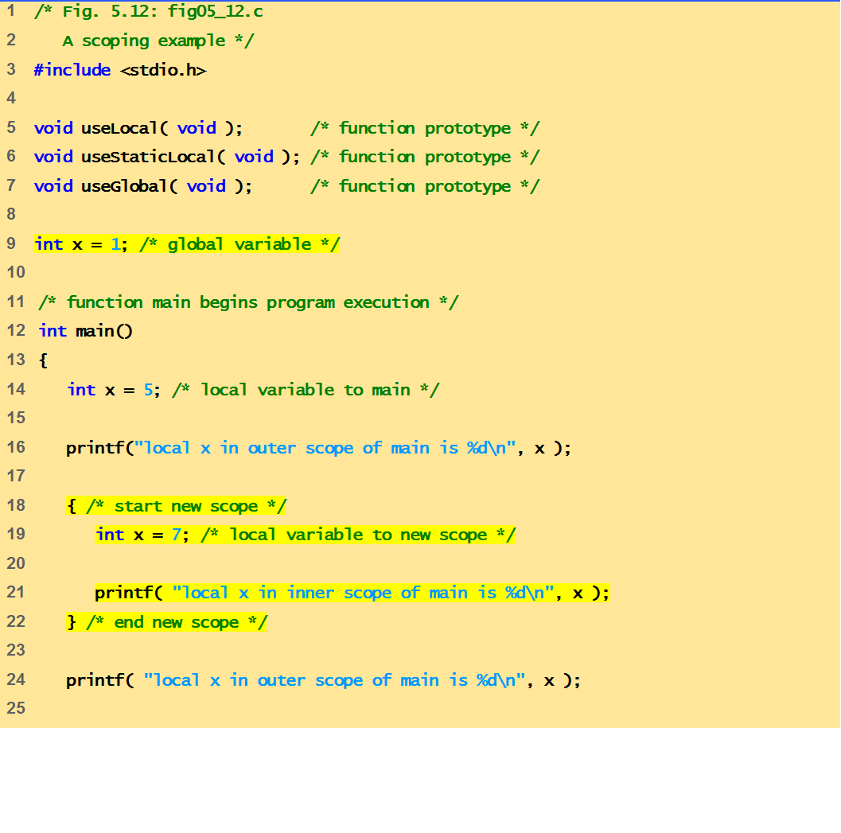
output
local x in outer scope of main is 5
local x in inner scope of main is 7
local x in outer scope of main is 5
local x in a is 25 after entering a
local x in a is 26 before exiting a
local static x is 50 on entering b
local static x is 51 on exiting b
global x is 1 on entering c
global x is 10 on exiting c
local x in a is 25 after entering a
local x in a is 26 before exiting a
local static x is 51 on entering b
local static x is 52 on exiting b
global x is 10 on entering c
global x is 100 on exiting c
local x in main is 5

Slide 17
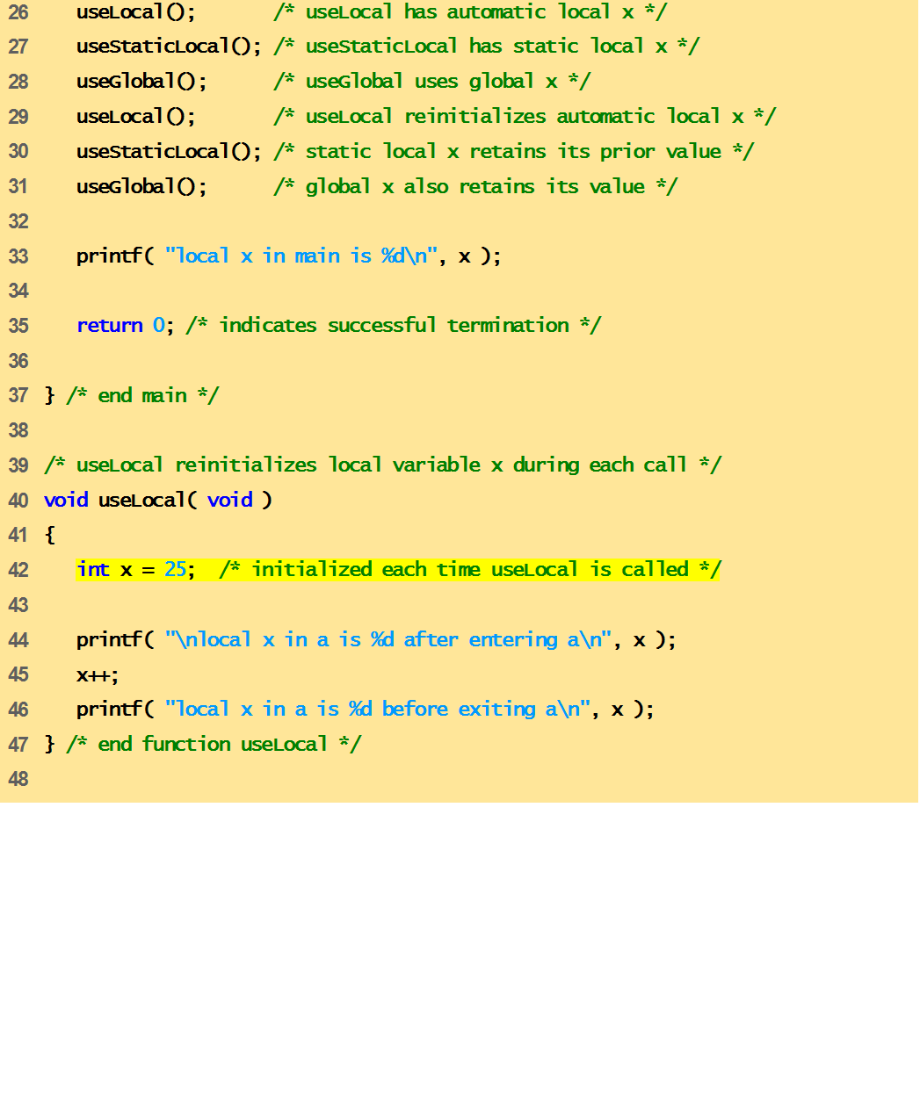
output
local x in outer scope of main is 5
local x in inner scope of main is 7
local x in outer scope of main is 5
local x in a is 25 after entering a
local x in a is 26 before exiting a
local static x is 50 on entering b
local static x is 51 on exiting b
global x is 1 on entering c
global x is 10 on exiting c
local x in a is 25 after entering a
local x in a is 26 before exiting a
local static x is 51 on entering b
local static x is 52 on exiting b
global x is 10 on entering c
global x is 100 on exiting c
local x in main is 5

Slide 18
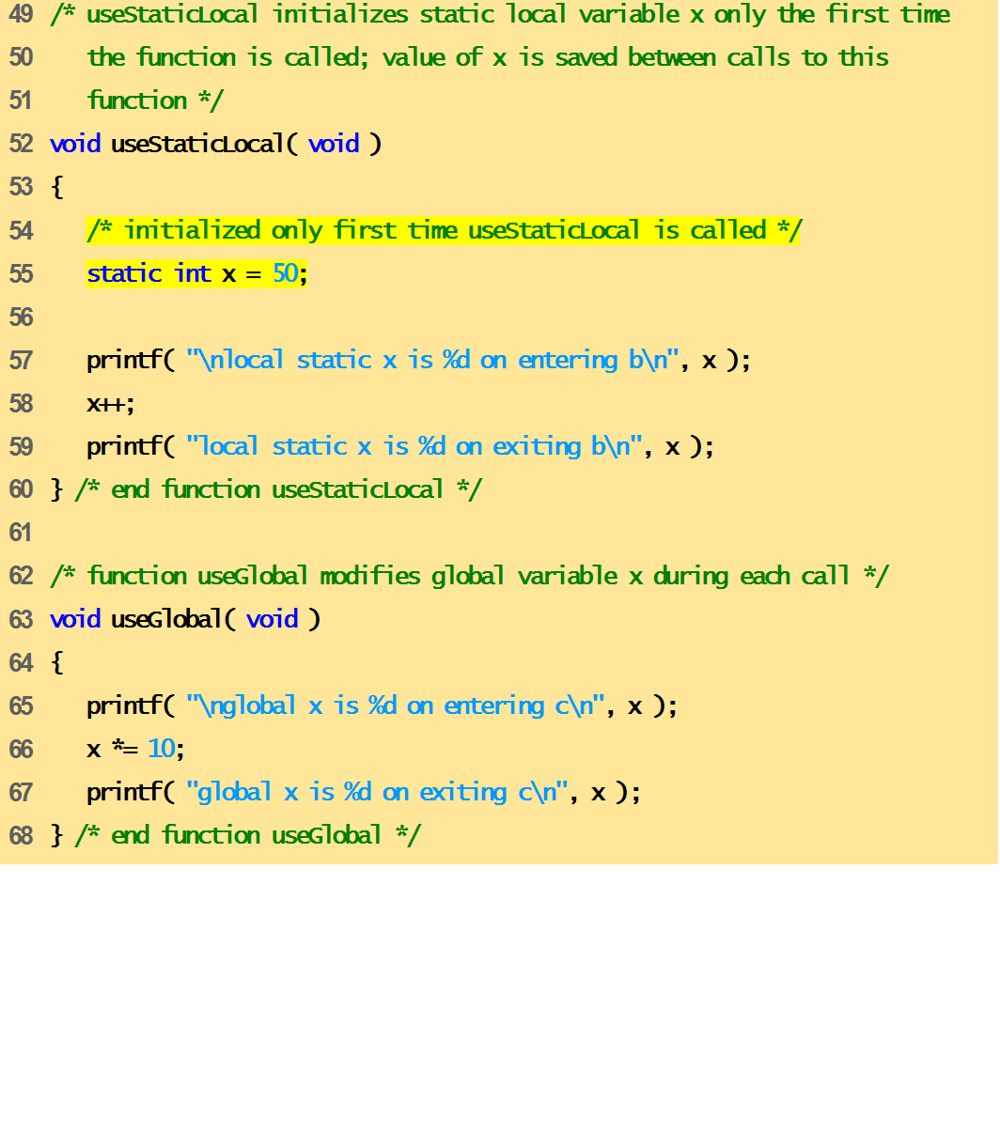
output
local x in outer scope of main is 5
local x in inner scope of main is 7
local x in outer scope of main is 5
local x in a is 25 after entering a
local x in a is 26 before exiting a
local static x is 50 on entering b
local static x is 51 on exiting b
global x is 1 on entering c
global x is 10 on exiting c
local x in a is 25 after entering a
local x in a is 26 before exiting a
local static x is 51 on entering b
local static x is 52 on exiting b
global x is 10 on entering c
global x is 100 on exiting c
local x in main is 5

Slide 19
output
local x in outer scope of main is 5
local x in inner scope of main is 7
local x in outer scope of main is 5
local x in a is 25 after entering a
local x in a is 26 before exiting a
local static x is 50 on entering b
local static x is 51 on exiting b
global x is 1 on entering c
global x is 10 on exiting c
local x in a is 25 after entering a
local x in a is 26 before exiting a
local static x is 51 on entering b
local static x is 52 on exiting b
global x is 10 on entering c
global x is 100 on exiting c
local x in main is 5

Slide 20
output
local x in outer scope of main is 5
local x in inner scope of main is 7
local x in outer scope of main is 5
local x in a is 25 after entering a
local x in a is 26 before exiting a
local static x is 50 on entering b
local static x is 51 on exiting b
global x is 1 on entering c
global x is 10 on exiting c
local x in a is 25 after entering a
local x in a is 26 before exiting a
local static x is 51 on entering b
local static x is 52 on exiting b
global x is 10 on entering c
global x is 100 on exiting c
local x in main is 5

Slide 21
output
local x in outer scope of main is 5
local x in inner scope of main is 7
local x in outer scope of main is 5
local x in a is 25 after entering a
local x in a is 26 before exiting a
local static x is 50 on entering b
local static x is 51 on exiting b
global x is 1 on entering c
global x is 10 on exiting c
local x in a is 25 after entering a
local x in a is 26 before exiting a
local static x is 51 on entering b
local static x is 52 on exiting b
global x is 10 on entering c
global x is 100 on exiting c
local x in main is 5

Slide 22
output
local x in outer scope of main is 5
local x in inner scope of main is 7
local x in outer scope of main is 5
local x in a is 25 after entering a
local x in a is 26 before exiting a
local static x is 50 on entering b
local static x is 51 on exiting b
global x is 1 on entering c
global x is 10 on exiting c
local x in a is 25 after entering a
local x in a is 26 before exiting a
local static x is 51 on entering b
local static x is 52 on exiting b
global x is 10 on entering c
global x is 100 on exiting c
local x in main is 5

Slide 23
output
local x in outer scope of main is 5
local x in inner scope of main is 7
local x in outer scope of main is 5
local x in a is 25 after entering a
local x in a is 26 before exiting a
local static x is 50 on entering b
local static x is 51 on exiting b
global x is 1 on entering c
global x is 10 on exiting c
local x in a is 25 after entering a
local x in a is 26 before exiting a
local static x is 51 on entering b
local static x is 52 on exiting b
global x is 10 on entering c
global x is 100 on exiting c
local x in main is 5

Slide 24
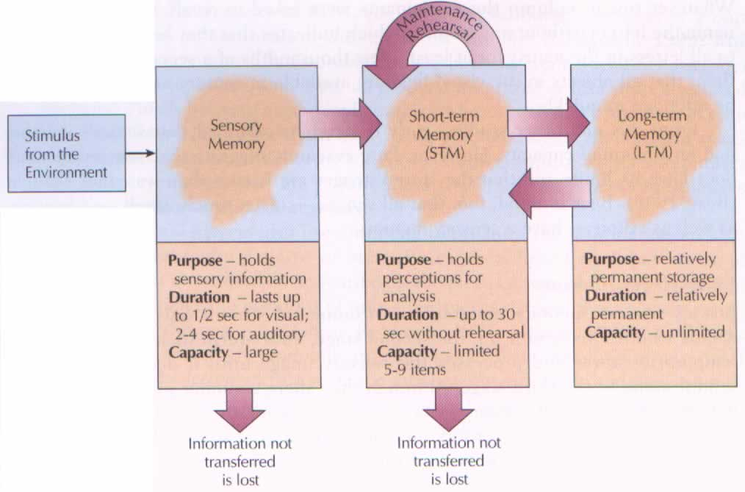
Example

